Slide 1

Advanced Clustering Techniques
Hierarchical & Gaussian Mixture Model Analysis on Social Media Usage Data

Slide 2




Recap: Dataset & Objectives
A quick reminder of the foundation of our exploratory data analysis and the core questions driving our models.
Our Dataset
Core Research Questions
5,000 Individuals: Comprehensive survey responses collected between Jan 2024 and Dec 2025.
Does increased screen time directly correlate with high-risk mental states?
How heavily do negative online interactions impact users' sleep and daily mood?
15 Features: Capturing digital habits, physiological health (sleep/activity), and platform preferences.
How do distinct populations cluster together based on engagement and mental state across different ages?
Key Metrics: Total daily screen time, social media time, and negative interaction counts.
Target Outcomes: Self-reported Anxiety, Stress, and Mood scores (1-10), mapping to overall Mental State classifications.
Does the choice of the primary social platform have a measurable link to user anxiety or stress?

Slide 3
Part 1: Theoretical Foundations
Exploring the mechanics of Hierarchical Clustering and Gaussian Mixture Models.

Slide 4






Hierarchical Clustering
•
Builds a tree of nested clusters (a dendrogram) by iteratively merging the closest groups based on relative distances.
Potential Pitfalls
Hierarchical algorithms scale poorly on extremely large datasets without subsampling, suffering from significant time and memory complexity:
•
Utilizes an agglomerative approach, meaning it starts with every data point as its own isolated cluster and merges upwards.
Merges are strictly irreversible, meaning early mistakes heavily propagate. Furthermore, it completely lacks built-in handling for noise or extreme outliers.
•
Merges the two nearest clusters at each progressive step until all points belong to one massive, final cluster.
•
Provides a deterministic, hard partition of the dataset without computing probabilistic boundaries.
hyperparameters:
n_clusters
linkage
metric

Slide 5




Gaussian Mixture Models (GMM)
Potential Pitfalls
•
Models the data comprehensively as a weighted sum of K independent Gaussian distributions, each possessing its own mean and covariance.
GMM explicitly assumes each cluster is roughly Gaussian, causing it to aggressively struggle with non-Gaussian, irregular shapes (e.g., rigid rings or crescents).
•
Unlike hard-assignment methods, GMM is intrinsically probabilistic: every individual point receives a strict probability of belonging to each specific cluster (soft assignment).
It remains highly sensitive to its initialization and is prone to settling in poor local optima. Components can completely collapse to a singular covariance when features significantly outnumber actual data.
•
Complex parameters are iteratively estimated and refined using the powerful Expectation-Maximization (EM) algorithm.
hyperparameters:
n_components
covariance_type
n_init

Slide 6
Part 2: Decision & Justification
Why PCA-2 Over Manual Dimensionality Reduction

Slide 7
Manual Dimensionality Reduction - Custom Axes
We engineered two interpretable indexes:
Digital_Habits_Index = (daily_screen_time_norm + social_media_time_norm) / 2
Mental_Strain_Index = (stress_level_norm + anxiety_level_norm) / 2
Feature set for clustering = [Digital_Habits_Index, Mental_Strain_Index] + all one-hot platform columns.
Why we did this: both axes have a clear human-readable meaning (digital usage vs. psychological strain); it reduces ~20 features to 2 meaningful dimensions plus platform identity; it is easy to explain to non-technical stakeholders.
Trade-off
we impose our own assumptions on the structure, and adding one-hot platform columns makes the clustering partly driven by which platform a user is on rather than by behaviour alone.

Slide 8
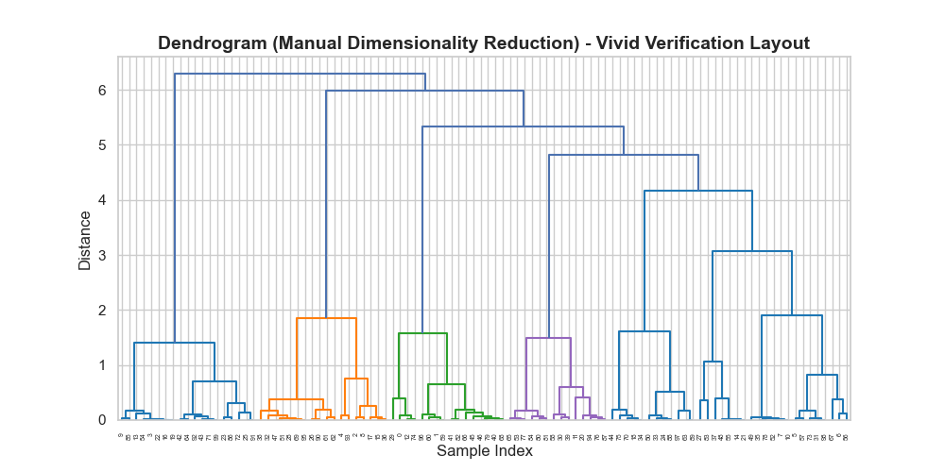
Manual Reduction - Dendrogram (Ward)
Max merge distance is only ~6.2. Several branches of comparable height with no single dominant top split, so the right number of clusters is more ambiguous

Slide 9
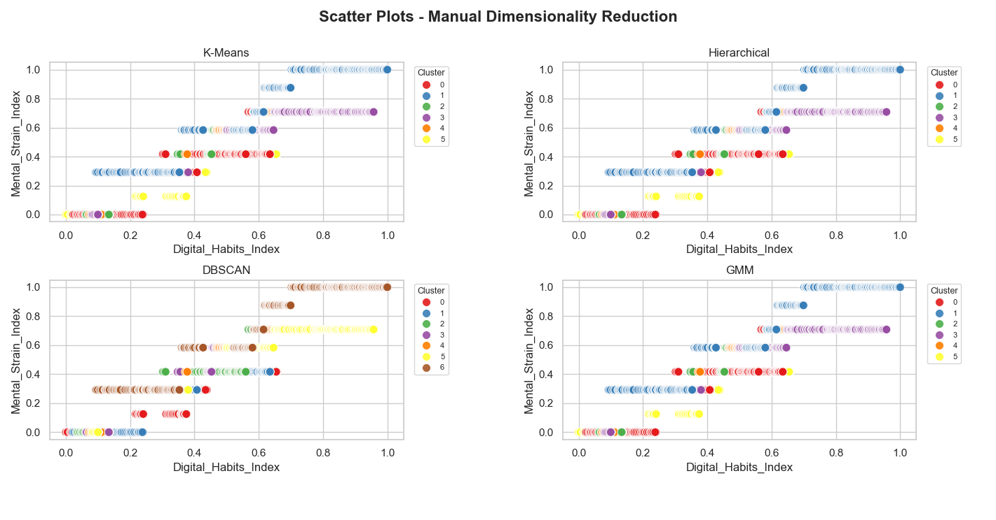
Manual Reduction - All Algorithms (Scatter)
Axes are interpretable (Digital Habits vs Mental Strain). K-Means / Hierarchical / GMM each find 3 groups, but boundaries overlap in horizontal bands. DBSCAN over-fragments into 7 clusters

Slide 10
PCA (2 Components) - The Data Chooses the Axes
PCA finds the 2 orthogonal directions that capture the most variance across ALL features (the 13 normalized numeric features + mental_state_encoded + platform/gender one-hots).
PCA2_1 and PCA2_2 are linear combinations of the original features - abstract and not directly human-readable, but mathematically optimal for preserving spread in 2D.
Why we did this: no manual assumptions, the structure emerges from the data; it captures correlations between many features at once; it produces the cleanest 2D separation for visualization and clustering.
Trade-off
components are harder to interpret. We read the top-loading features (printed by the script) to label what each axis roughly represents.
Top features
PCA_1:
stress_level, anxiety_level, mood_level, sleep_hours, physical_activity_min
PCA_2:
social_media_ratio, platform_WhatsApp, daily_screen_time_without_social_media_min, platform_TikTok, sleep_hours

Slide 11
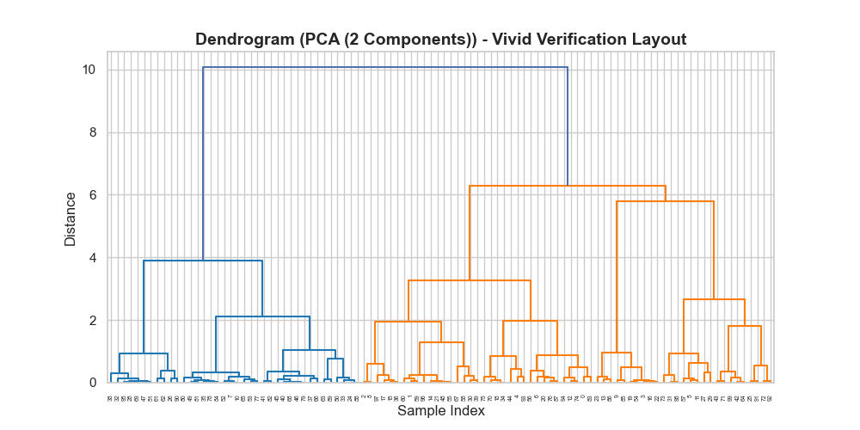
PCA-2 - Dendrogram (Ward)
One dominant top split at distance ~10, then a clear secondary split at ~6. The large vertical gaps make a cut into 3 clusters a natural, decisive choice (justifies n_clusters=3).

Slide 12
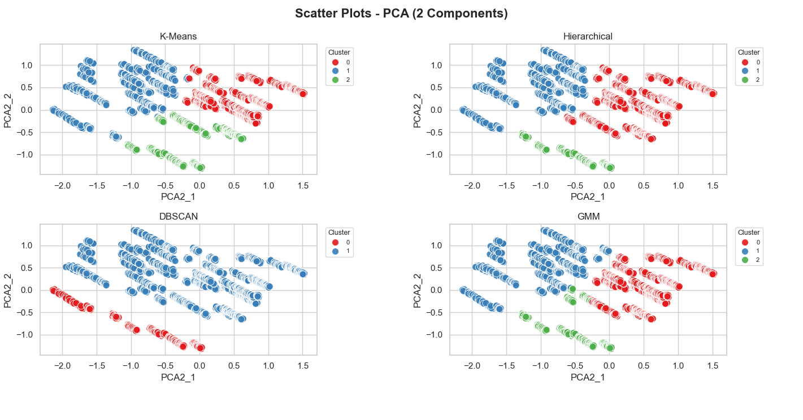
PCA-2 - All Algorithms (Scatter)
K-Means / Hierarchical / GMM agree on 3 clean, well-separated clusters. DBSCAN under-segments into ~2 clusters here - again showing density parameters must be tuned to the representation.

Slide 13
Our Choice: Why We Prefer PCA-2
We use PCA-2 as the primary representation because it yields the clearest, most stable 3-cluster structure that Hierarchical and GMM agree on. We keep the Manual reduction as an interpretable cross-check for explaining what distinguishes the groups in plain language.

Slide 14
Part 3: Clustering choice
Silhouette coefficients comperacence

Slide 15
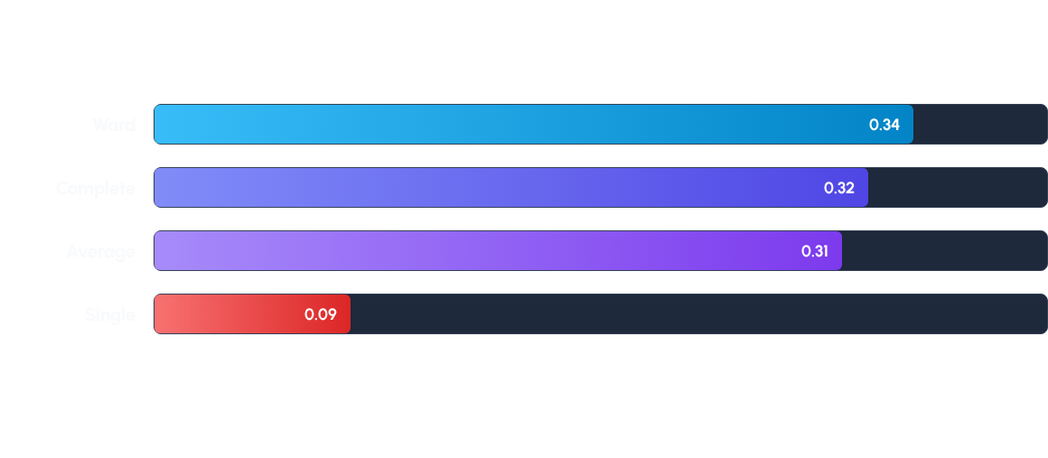
Hierarchical Results (K=3)
Silhouette coefficients across different linkage methods at exactly 3 clusters.
Ward linkage predictably yields the absolute optimal silhouette score (0.34). Single linkage performs exceptionally poorly as it aggressively chains almost all points into one large cluster with a few tiny outlier groups.

Slide 16
GMM Performance Matrix
Silhouette coefficients evaluated systematically by covariance type and component count (K).
Clusters (K) | Full Covariance | Tied Covariance | Diag Covariance | Spherical Covariance
K = 2 | 0.32 | 0.30 | 0.30 | 0.28
K = 3 (Optimal) | 0.35 | 0.32 | 0.32 | 0.29
K = 4 | 0.31 | 0.30 | 0.29 | 0.27
K = 5 | 0.28 | 0.27 | 0.27 | 0.24
Full covariance explicitly paired with 3 components provides the absolute highest silhouette score (0.35) and actively minimizes BIC.

Slide 17
The Optimal Choice
Both algorithms independently and consistently identify that 3 clusters best segment this specific user base. Visualizing the PCA projection completely confirms three distinct groups.
Ultimately, GMM slightly edges out the hierarchical approach (0.35 vs 0.34 silhouette) because it offers reliable confidence probabilities per point and far better models the correlated features of the dataset.

Slide 18
Part 4: Practical Application
Analyzing behavioral user segments.

Slide 19

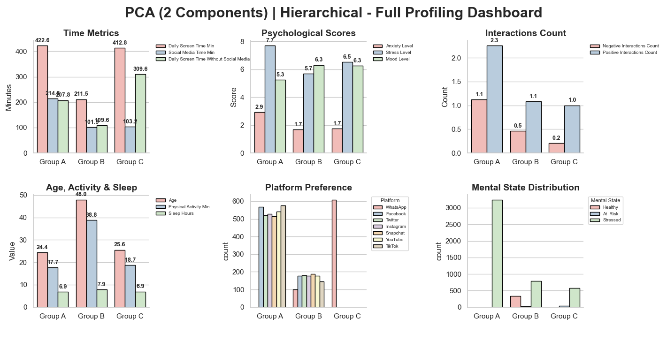

Slide 20
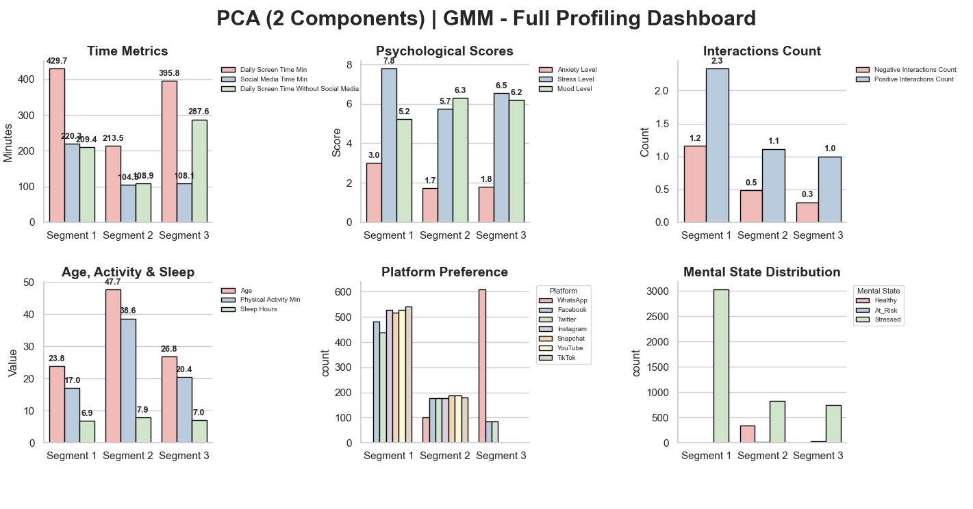

Slide 21
Questions?

